Slide 1
Falco Van Haut
210543 Applied Computer Science
PROGRAMMING
[photo]
CMGT Intake
2021-22

Slide 2

How To Use
This Template
As an applicant at Breda University of Applied Sciences for the Creative Media and Games Technologies (CMGT) undergraduate programme you are required to provide evidence that demonstrates your current level and other factors required for pre-selection assessment and potential interview.
With the evidence you present here teachers should obtain a clear and comprehensive overview of your current state of progress as well as your general attitude and performance as a student and as an aspiring professional developer.
This presentation is intended to provide you with a well-structured and organised format for doing this effectively. Please follow the directions on each slide to help ensure you supply the information required. You should use and update the presentation attached to the assignment in Teams (do not delete or replace this as this breaks the link). Please do not spend time formatting the style of the presentation. Only insert extra slides where it says you can otherwise use the space, word count and font size provided. Also be sure to add your details where requested (e.g. on the first slide).
Make sure to read the Variation Assignment on Teams carefully. Evidence needs to be provided in this presentation as well as during the interview (if applicable).

Slide 3
Section A – Motivation
A1 Why Games@BUas
A2 Future Career Ambition
A3 Interview
Section B - Suitability
B1 Study Skills & Reflection
B2 Best Teamwork Examples
B3 Other Interests
B4 Documentation & Written English
Section C - Portfolio/Assignments/Tests
C1/2 Variation Assignments
C3 Assignment Reflection
C4 Relevant Portfolio, Skills & Knowledge
Presentation
Structure

Slide 4
Section A
A
Motivation (20%)

Slide 5
A
(A1) Why Games@BUas
I’ve always intended to at some point enter the gaming industry; both creating and programming are passions of mine and working on games has always been the end goal for me. Initially I thought getting a general computer science degree would be the more sensible option, with the intention of going into the gaming industry afterwards, but as I’m currently a year into it I can confidently say that it doesn't feel right. Say I graduate here, the market for game development is incredibly small in Belgium and it’d be a lot more difficult to get into the market without any prior connections or experience, which BUas provides. Additionally, the course material isn't exactly what I I'd want to be doing. While I've been able to handle myself perfectly fine, the more theoretical approach really isn't for me.
Hence why I started looking into other alternatives, such as BUas. When looking into it, it honestly seemed perfect; a focus on self-study, the absence of exams, the connections with gaming companies and the like, it really spoke to me. I've never been the biggest fan of exams, in the sense that knowledge gained through experience rather than through study has always stuck with me much more. Exams tend to be more a memorization test than an actual test of expertise I feel, and I've always been a fan of studying and learning by myself. I learn myself a lot of new stuff regularly, purely out of interest, so I feel like this would be perfect for me.

Slide 6
A
(A2) Future Career Ambition
Ideally, I’d love to start my own studio. Sadly, I realize that might be unrealistic, or at least very difficult, and that a more realistic career would probably be a programmer in an already established studio. However, given that I start my own studio, the ideal goal would be to finish my studies at BUas, first work in the industry a few years to create some connections, fill out my resume so publishers would have more trust in the company and to find people interested in starting a studio (designer(s) and visual artist(s)), then invest a certain amount of money into creating a proof of concept for a first game. With this, we could pitch this idea to publishers (choosing publishers based on past record, reputation, etc at places like GDC, for example).
That'd really be the "make or break" of the hypothetical studio; getting a game funded by a publisher would at least start us off somewhere. And this is where attending this school becomes important; given I go through with the plan to start a studio, this school would help a lot in getting me a job at a game development company, after which I could go on to start a studio with the experience gained. And getting into the industry to get this experience is a lot easier given that I attend BUas. I know starting a studio is a huge effort, and so is developing a game itself, but I'm incredibly passionate about starting a company and in all honesty, given the scenario that I don't get into BUas, I would still attempt to start my own studio or get a job in the gaming industry all the same. It'd be a lot more difficult in that case, however.

Slide 7
A
(A3) Interview
You do not need to do anything for this slide, this is for information only. If you are successful in pre-selection then you will be invited for an interview. The interview will allow you to show aspects from your portfolio or previous experience for the interview team to explore in more depth. The interview will also demonstrate your current level of spoken English. The interview allows you to demonstrate your motivation for this study along with the professional attitude required of a game developer.
The interview will be done online via Microsoft Teams and will take 15 minutes where 5 minutes can be used for you to present with the remaining 10 minutes being a question and answer session.

Slide 8
Section B
B
Suitability (30%)

Slide 9
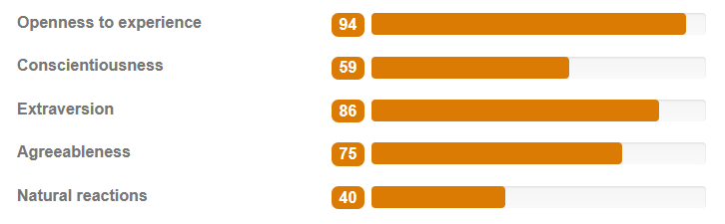
B
(B1) Study Skills & Reflection
Please use this space to reflect on your scores. Do you recognize the results? Can you give examples why? How might the results affect your study? How do they reflect how you work in teams?
MAX 150-300 words (do not change font and/or font-size)
I agree with most of this; I tend to be very open to new experiences, which is reflected through the various projects, hobbies and interests I occasionally dive into, which have a lot of variation among them, going from cryptocurrency bots made in python (which is the project I’m going to start working on next) to learning how to draw, which I’ve been doing for the last few years now.
My work ethic could use some work however; while I like working on projects that interest me, I tend to easily get distracted which leaves me to not be as efficient as I could be. This will then result in small, panic-induced bursts of work which happen at irregular intervals. During these bursts of work, granted I’ll get a lot of work done, but I’d prefer to iron out the irregular schedule. I try to set boundaries for myself, allocating certain dates and hours of the day as dedicated work hours where I try my best not to get distracted. This is often a bit detrimental for in the scenario of teamwork as it’s hard for my teammates to know when I’m working, I will admit, but I will always be finished by the deadline. However, doing more work earlier is also a point I am working on.
Additionally, I tend to talk to people easily, and I have no problem being very open even at a first meeting. That doesn’t mean I don’t get flustered; drastic changes in social situations often take a bit to get used to (although I don’t usually show much of that), which is reflected by the 40 I have on my natural reactions. On agreeableness; I prefer working alongside people and getting everyone motivated, so I agree with the scores there too.
Please do the test on this website:
www.123test.com/personality-test/
Insert a screenshot of your results below.

Slide 10
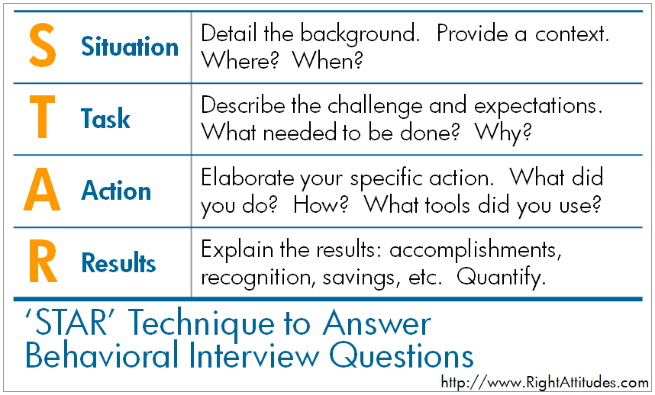
B
(B2) Best Teamwork Example
Situation: We were working on a game in the university course I’m currently in, working together with a group of 5 people, including me. The workload was distributed between the group members, and we were supposed to present this game in front of a jury. For context, the game we made was assigned us by our teachers (in our case, we made minesweeper). The game was written in java, played in console, stored high scores on an ubuntu server and had to be downloadable from a website hosted on a server the school provided us. Task: Communication among teammates was going pretty rough at first, so I took it on me to start organizing meetings and to properly establish who does what task, even though we had a project manager who was supposed to be handling that stuff.
Action: I set up a discord server and organized meetings, I helped my teammates with their tasks alongside making my own, and we held meetings wherein teammates explained their parts of the game to others, so everyone knew what the others were doing.
Result: When presenting our game in front of a jury, everyone ended up being knowledgeable about various parts of the game, and I ended up answering a lot of questions about various parts of the project.

Slide 11
B
(B3) Other Interests
Please provide an overview and motivation of your main pursuits/passions/hobbies besides study related topics.
MAX 150-300 words (don’t change font and/or font-size)
I honestly have a bunch of interests I’d eagerly describe as hobbies, but to list some; Even outside of study related projects, I like programming different things, I’m currently starting work on 2 projects, a simple unity game and a cryptocurrency trading bot I’ll be working on with a buddy of mine. Additionally, I really like drawing, and have been developing for the last 3 years now, however I have yet to make a place to publicly share my art. I additionally like writing, I’ve written up various drafts for stories I’d like to tell (a comic, and currently a story for a game), which I’m planning to start working on properly sometime in the future. I like games, mainly singleplayer games, with Dark Souls and Hollow Knight as some of my favourites and I occasionally host DnD sessions with my friend group for which I’m usually the DM. To list a few others quickly; I started working out before covid hit, I like listening to music (any genre, from Iron Maiden to Death Grips to Gorillaz), going out with friends, and I like watching movies and shows.

Slide 12
B
(B4) Documentation & Written English
You do not need to do anything for this slide, this is for information only. Please keep this presentation tidy, stick to the formatting guidelines and word counts. Make sure your additions are well written and avoid any grammar and/or spelling mistakes.

Slide 13
Section C
C
Portfolio/Assignment/Tests (50%)

Slide 14
C
(C1) Programming Assignment - Part One: Programming a C++ Game Images of Your Game
Add images of your final game running. Add one sentence per image describing what the image is about. You optionally also embed an mp4 (video) here but keep this no longer than 10 seconds (instructions on doing this can be found here).
(images added in following slides)

Slide 15
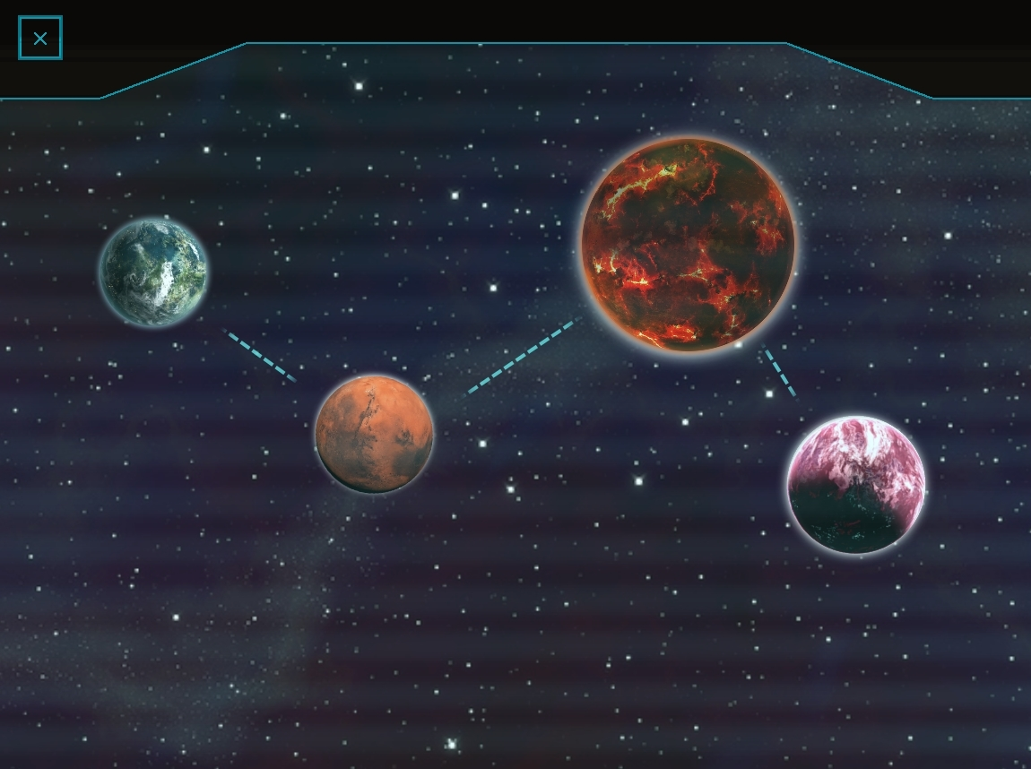
The main menu, where you can select
One of four worlds, which all have different effects on the game.

Slide 16
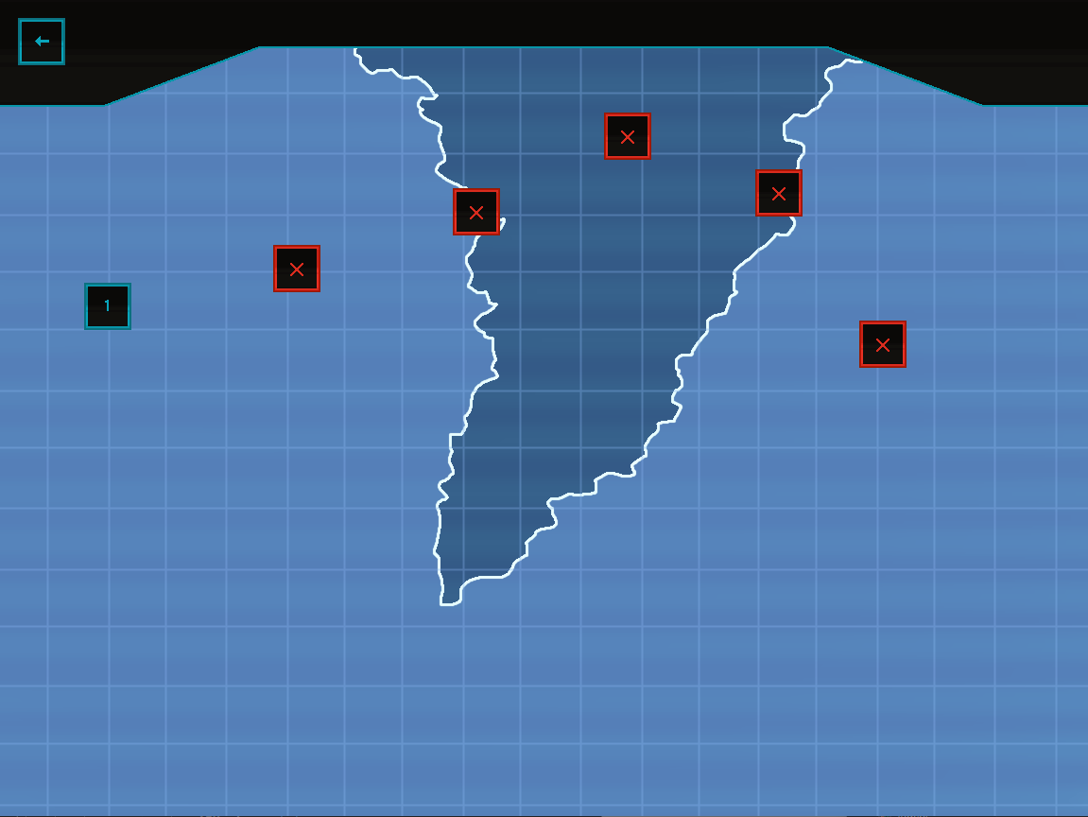
The level selection, where you select one of the 6 levels per world, this being the first world.

Slide 17
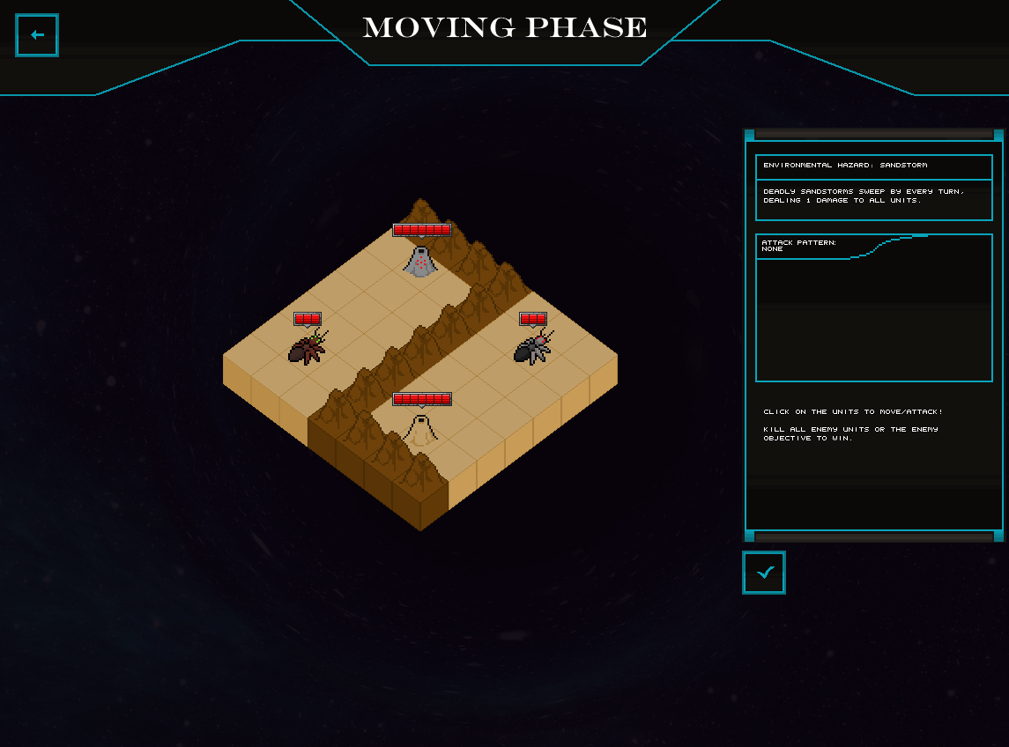
How the game looks while in game.

Slide 18
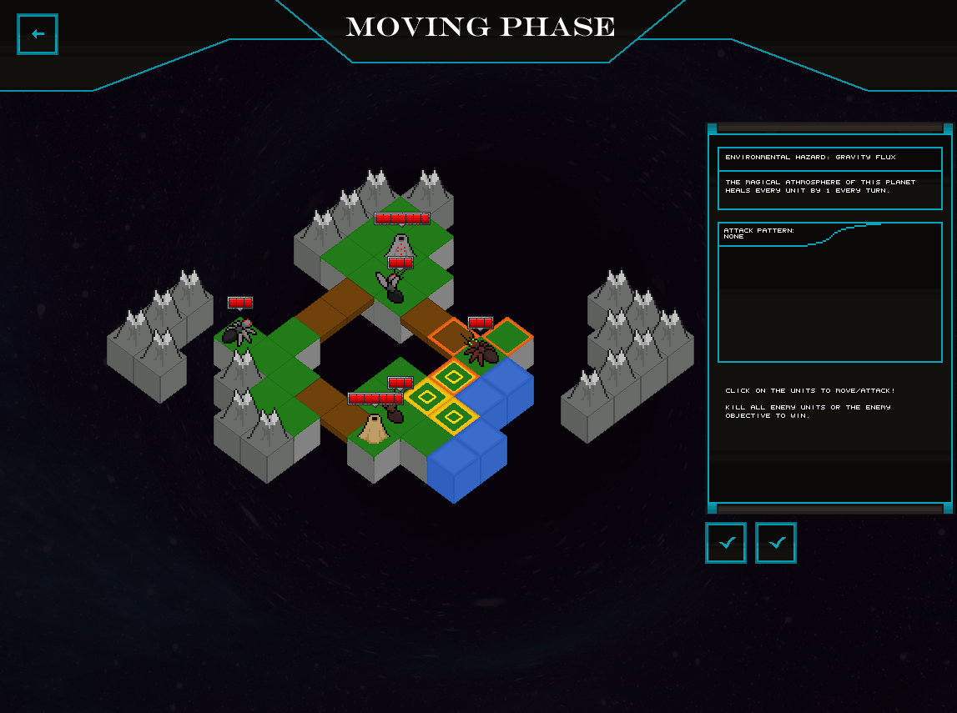
The player moving their units, and the trail of past moves the player has made.

Slide 19
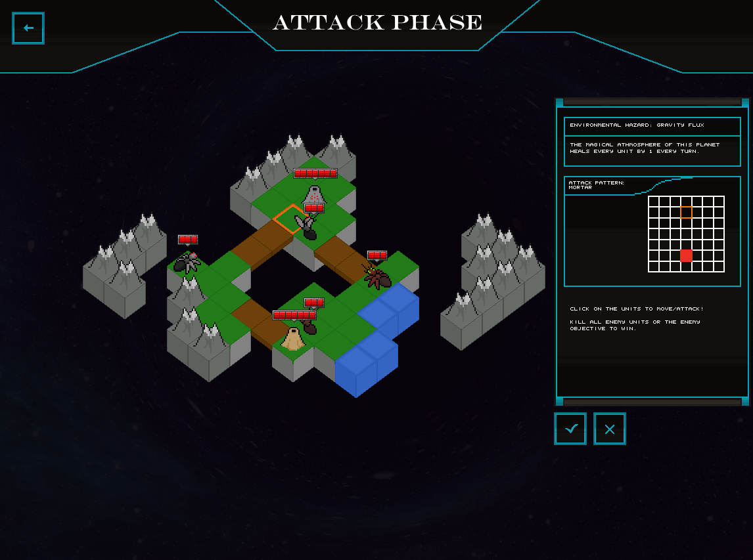
The player attacking with their units, showing the attack pattern on the right and the place the attack will hit on the field itself.

Slide 20
C
(C1) Programming Assignment - Part One: Programming a C++ Game Code Snippet and Explanation
Share here one code snippet (this can be an image if easier) of something you programmed that you are most proud of or found most challenging. Then add one paragraph explaining this here.
(image included on next slide)
I debated on whether to use this or the level loading code, but ended up choosing this because this was more challenging to write.
The code on the next slide is the code that calculates the path from one spot on the map to another, based on the movement rules of a certain unit. What happens is the following; It checks the starting square and marks it. It then loops over the entire field again, now checking all marked fields as it checked the original, marking all the tiles around it too. This recurses until the square the unit is supposed to end up on is found, at which point the correct path is saved and the function is ended. Another cool thing with this function, is that it’s simultaneously used to calculate a path and to check if a unit can actually reach a certain field, returning true if it can and false if it can’t.

Slide 21
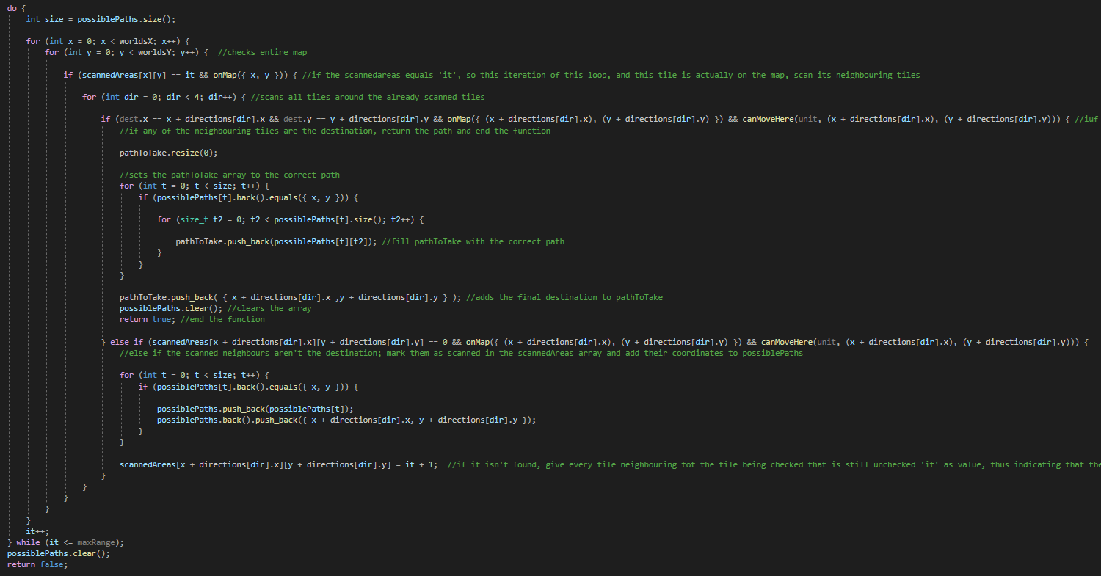

Slide 22
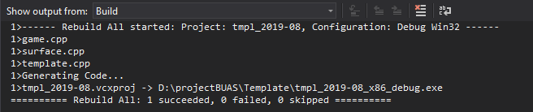
C
(C1) Programming Assignment - Part One: Programming a C++ Game Rebuild Solution Log
Please place your compile log here (image if this is easier) from a “Rebuild Solution”.
Please replace this example image:

Slide 23
C
(C2) Programming Assignment - Part Two: HackerRank Challenge Your HackerRank Details
This is to be completed individually where you have up to 150 minutes to complete so please make sure you have time to do so. Also complete this after the Programming Assignment Part One as the knowledge gained might help you. When you finish, fill in the highlighted yellow sections below. Note that this must be done to be considered for pre-selection and interview.
If you already have a HackerRank account, then use that otherwise use your own personal email to create one as this can be a part of your future portfolio. Once logged in please go here
PLEASE CONFIRM
1. What email address did you use for the HackerRank challenge? Falco.van.haut@gmail.com
2. For the HackerRank challenge you did not consult/copy code from any source including a website, book, or friend/colleague to complete these tests, though may reference language documentation or use an IDE that has code completion features. Was this the case? YES
3. How did you think you went? It went decently well, I started with the last question and finished that in about 20 minutes, after which they all went smoothly. I’d say the prime one was the hardest for me (maybe not the hardest but the one that took the longest to finish).

Slide 24
C
(C3) Assignment Reflection
What did you learn?
What could you do better?
Please describe and explain what you have learned while doing the intake assignments.
MAX 150-300 words (don’t change font and/or font-size)
I’ve realised the importance of planning when developing a game; not even in the design sense, but preplanning on how to best store data and how to most efficiently approach certain scenarios is really important. Of course, that seems obvious in retrospect, but looking back, it surprises me how much work I did early on which I had to redo later on because it was inefficient, or just simply didn’t work anymore. I feel like I’ve also gotten better at disciplining myself to work, as I feel like I did a lot of work over a fairly small period of time for my admittedly limited level of expertise.
From a more technical standpoint, I learned how to work with C++/C on a fairly general level, although I still want to learn how to work within an engine properly, and I’d really like to learn how to use stuff like OpenGL properly. (I’m actually planning on learning this by myself pretty soon)
I’ve mentioned this, but I still feel like I could improve on my work ethic. I did a lot of work within a pretty small timeframe, but I realise I definitely could’ve worked more.
To go off of what I wrote in the section to the left, I feel like I could plan out my code better if I did it early on. To give an example, in my game, I rewrote the code which stores the levels at least 3 times over the course of development. The method of actually loading in levels also changed several times, starting out from global variables, to reading a set of files and storing all the data in an array of levels, to only storing the current levels and only reading from the file when a new level is loaded.
I also intend to use the capabilities of C++/C more, as I feel I kind of underused pointers in some areas of the game, and the code I used to render my game also seems pretty suboptimal. (e.g.: I could potentially optimize the rendering of the background images with stuff like memcpy, rather than using the template’s draw function)
Another thing is that I should have used multiple files for all my code, such as cpp files for different objects and parts of the game. I can imagine this really slows down the game, but I just didn’t really know how to tackle using multiple files in a hand built project, however I did work in separate files for objects when I worked within Unity.

Slide 25
C
(C4) Relevant Portfolio, Skills & Knowledge
Please use this space to add examples of your best work from your portfolio, study or work history that are relevant to game development or the discipline you are applying for.
You can also include:
A list of skills & knowledge relevant to game development or becoming a successful student.
Activities you currently do to prepare yourself for our study & future in games development.
Links to examples of your work or portfolio website (but most important information should be in this presentation).
Insert up to 5 slides here. Images are allowed with a maximum 150-300 words per slide (don’t change font and/or font-size).

Slide 26
C
(C4) Relevant Portfolio, Skills & Knowledge
Tempus.inc
Tempus.inc was a game I made with a friend as our final project for high school. The game is made in Unity and written in C#, mainly because Unity is easier to get into than Unreal Engine is, and C# is offered as the default for Unity. Considering we hadn’t ever used C# before, we thought this would be an interesting learning experience. I do have to comment, the game itself isn’t that good. Especially when we just started out, we made very slow progress and the code we wrote then is very janky, so there’s a few bugs.
Additionally, the gameplay doesn’t feel quite right, and it has a lot of unnecessary features which could easily have been left out and made the game better for it. The reason these features are here however is because this wasn’t so much a game as it was a way for us to demonstrate our coding skills through a project, and so we added a bunch of features just to showcase that we had the skills to implement said features.
As I said, I made this game together with a classmate, but I programmed the bulk of the gameplay and the random level generation, alongside making most of the art for the game. (Which, I have to say, I’m very proud of).
The game itself is a 2D roguelike with random map generation. The player travels through rooms, akin to the map generation in games such as the binding of Isaac, in an attempt to find 3 special rooms, which randomly show up. When the player has found 3 such rooms, they find a final room where they can end the game (There was originally going to be a boss fight here, but it never ended up actually being implemented due to time constraints)
Link to the itch.io page:
https://santer.itch.io/tempus-inc
The password is ‘Password’.

Slide 27
C
(C4) Relevant Portfolio, Skills & Knowledge
Skills
Quick and adept learner, being able to quickly understand new concepts.
Incredibly motivated to start working on games.
Experience with the following languages, either through school or through hobby work, in no particular order: -C# -C/C++ -CSS/HTML -Java -Javascript -Python -SQL -VB.Net
Only few of these are applicable to game programming, but I thought to list them all, if just to prove that I’m interested in learning new things
Decently experienced with Unity (although we’ll be using Unreal Engine, I imagine some of the skills garnered from toying with unity will still translate)
Creative, both in problem solving as in art/storytelling
Decently expansive knowledge about design and moderate artistic skills (these are not applicable to the study, but given my goal of starting an indie studio, these two might come in handy)

Slide 28
End of Presentation
Thank you for participating in the intake for
Games @ Breda University of Applied Sciences

